Slide 1


Updates
Olivier Bergeron

Slide 2

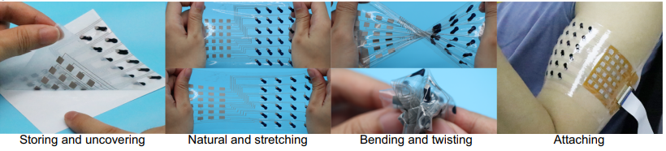
Interesting articles
Stretchable surface electromyography electrode array patch for tendon location and muscle injury prevention

Slide 3
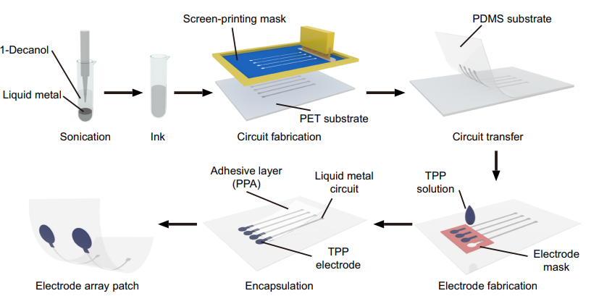
Interesting articles

Slide 4
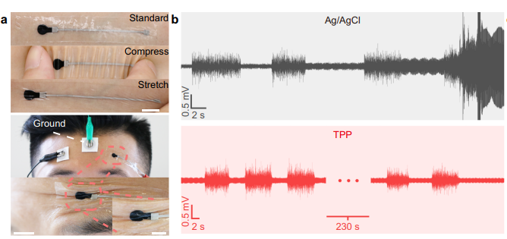
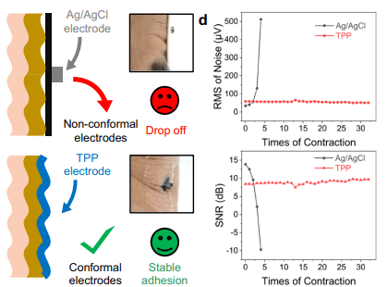
Interesting articles

Slide 5
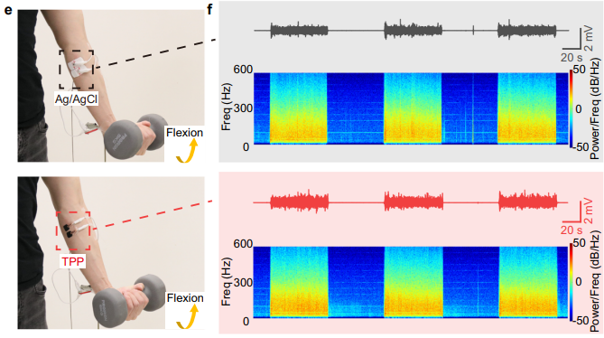
Interesting articles

Slide 6
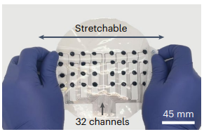
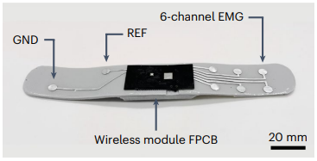
Interesting articles
A simplified wearable device powered by a generative EMG network for hand-gesture recognition and gait prediction
Pre-training electrode grid
Device used after pre-training

Slide 7
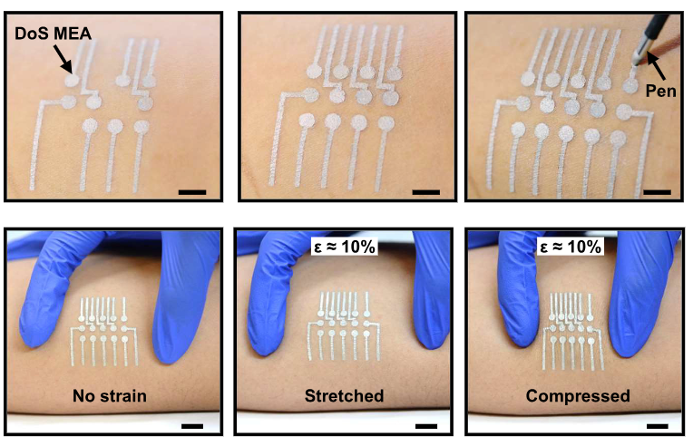
Interesting articles
Customizable, reconfigurable, and anatomicallycoordinated large-area, high-density electromyographyfrom drawn-on-skin electrode arrays

Slide 8
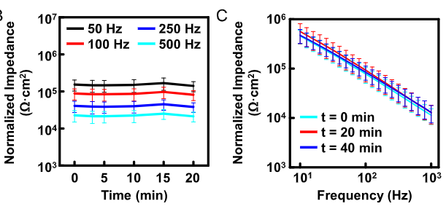
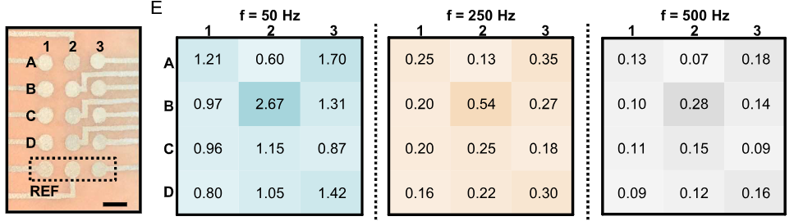
Interesting articles
3 mm diameter
5 mm IED
12 electrodes

Slide 9
FPGA
Small discussion with David-Alexandre:
By his tests, it is possible to use a very channel count @ 2 kHz (> 300)
Even if not mandated, that means a wearable prototype can be made

